Slide 1



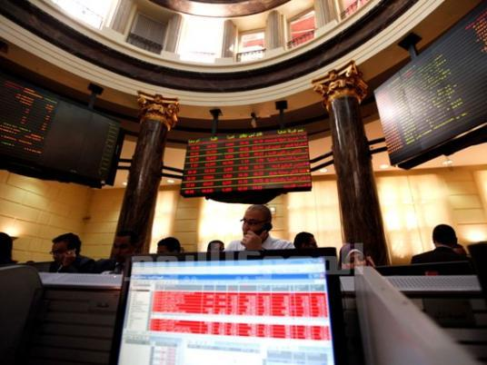
Periodic interests (1) Prof. Dr. Mohamed Mohamed Mohamed Atta

Slide 2

Periodic interests
The debtor paid all interests in the time.
The debtor paid first Part of interests in the time, then he was late till the end of the loan.
The debtor paid the first Part interests in the time, then he was late. He unpaid interests and principal after the end of loan term.

Slide 3
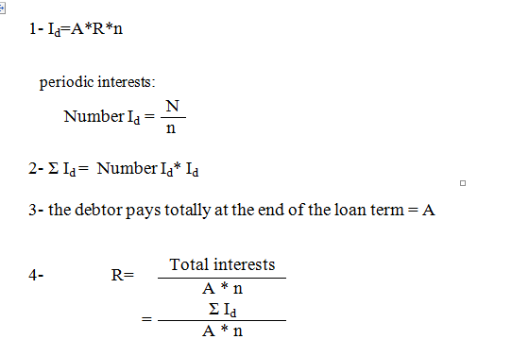
Case I: The debtor paid all interests in the time:

Slide 4
Example 1:
A person borrowed 10000 $ from Misr Bank for five years. He wanted to repay it in the form of periodic interests every six months at an interest rate 10 %. The debtor paid all interests in the time.
Get the following:
1- periodic interest and total periodic interests.
2- What the debtor pays totally at the end of the loan term.
3- The general interest rate that the debtor reached.

Slide 5
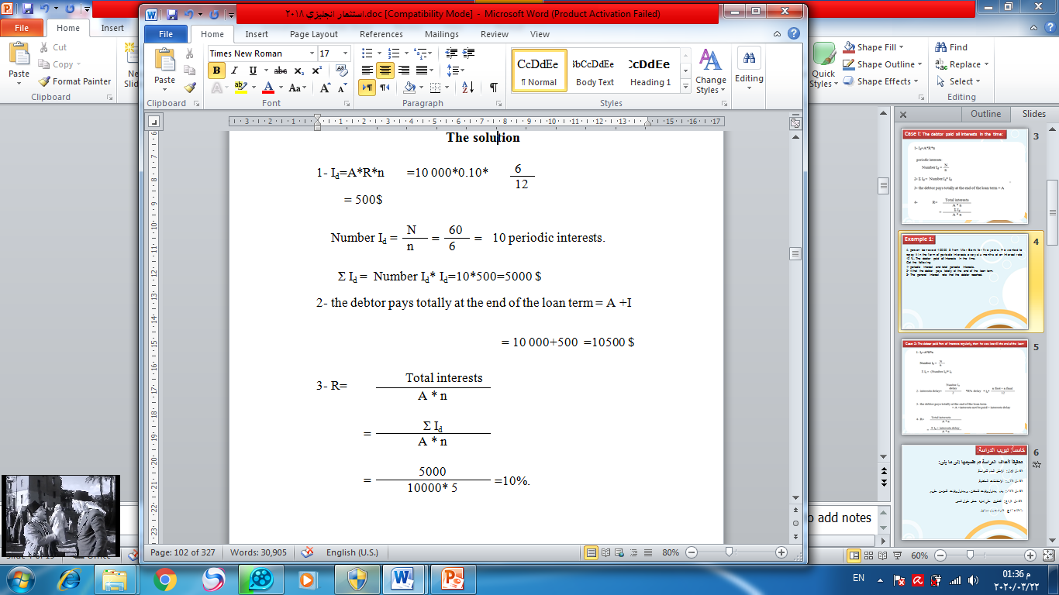
The solution

Slide 6
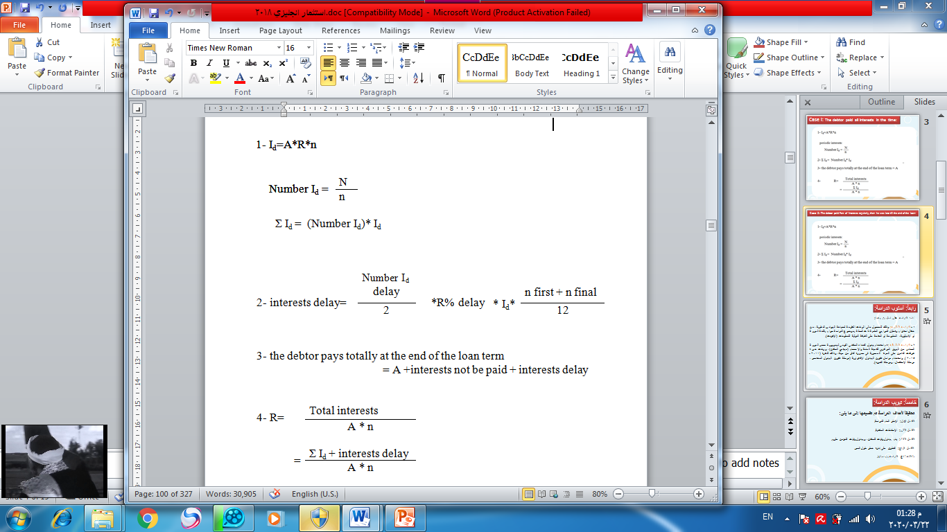
Case 2: The debtor paid Part of interests regularly, then he was late till the end of the loan:

Slide 7
Example 2:
A person borrowed 10000 $ from Misr Bank for five years. He wanted to repay it in the form of periodic interests every six months at an interest rate 10%. The debtor paid the first five interests regularly, then he was late till the end of the loan. At the end of the loan term, he paid the principal and late interests at late interest 20%.
Get the following:
1- periodic interest and total periodic interests.
2- Interests of interests delay
3- What the debtor pays totally at the end of the loan term.
4- The general interest rate that the debtor reached

Slide 8
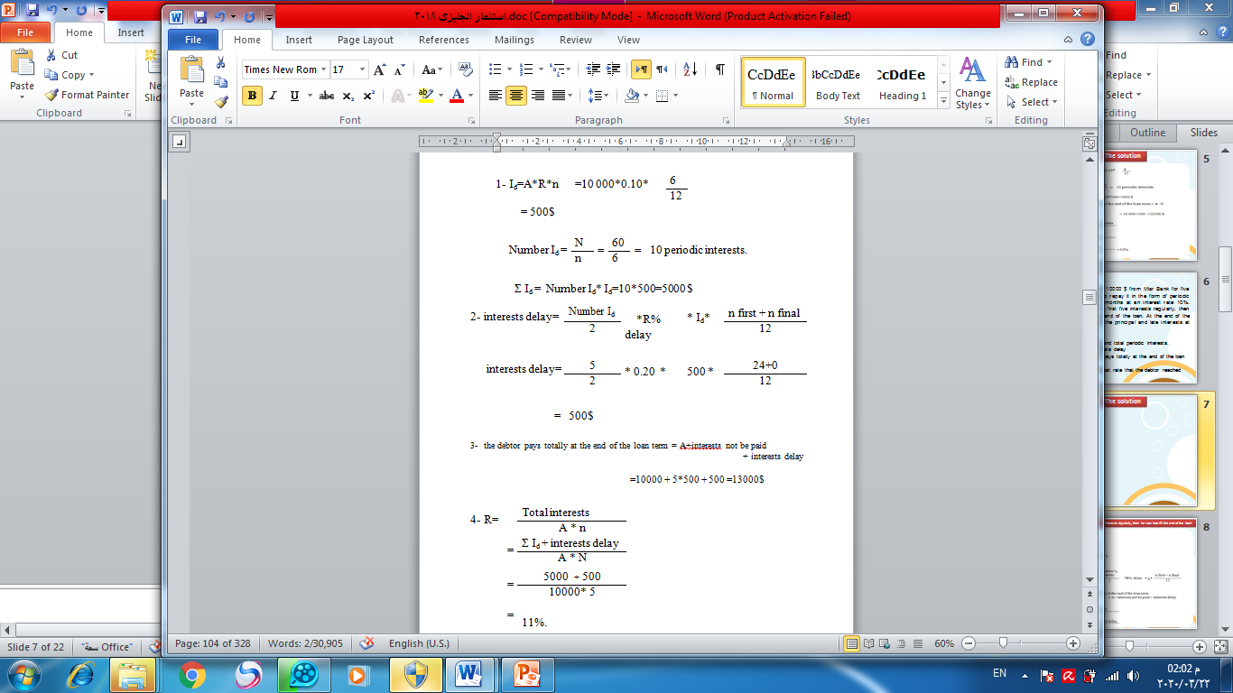
The solution

Slide 9
Example 3:
A person borrowed 20000 $ from Misr Bank for Two years. He wanted to repay it in the form of periodic interests every six months at an interest rate 10%. The debtor paid the first two interests regularly, then he was late till the end of the loan. At the end of the loan term, he paid the principal and late interests at late interest 20%.
Get the following:
1- periodic interest and total periodic interests.
2- Interests of interests delay
3- What the debtor pays totally at the end of the loan term.
4- The general interest rate that the debtor reached

Slide 10
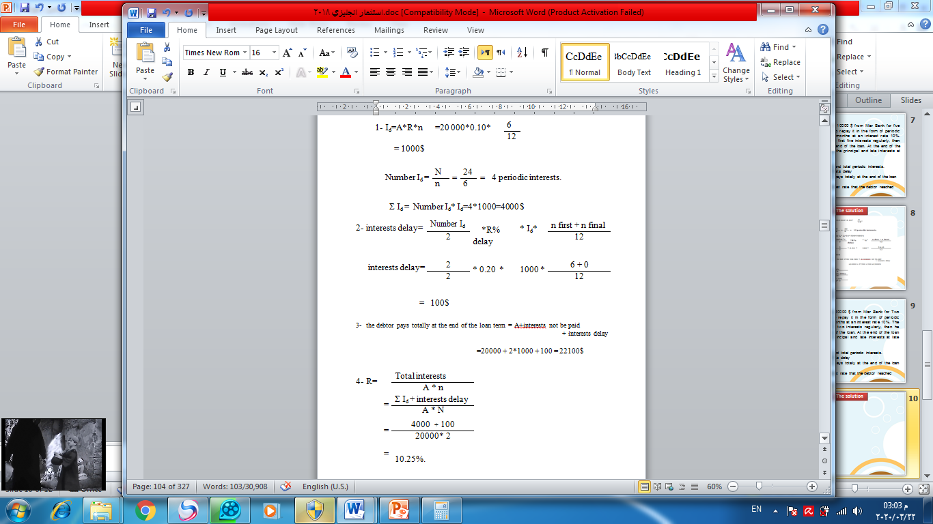
The solution

Slide 11
With best wishes

