Slide 1



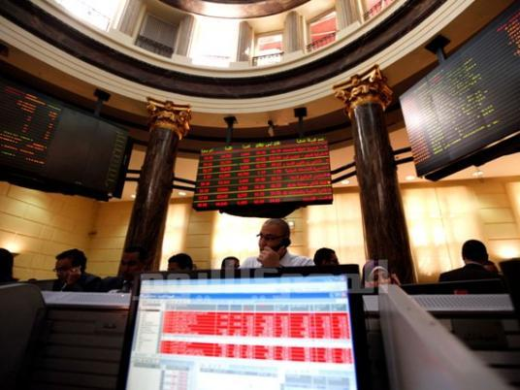
Periodic interests (2) Prof. Dr. Mohamed Mohamed Mohamed Atta

Slide 2

Periodic interests
The debtor paid all interests in the time.
The debtor paid first Part of interests in the time, then he was late till the end of the loan.
The debtor paid the first Part interests in the time, then he was late. He unpaid interests and principal after the end of loan term.

Slide 3
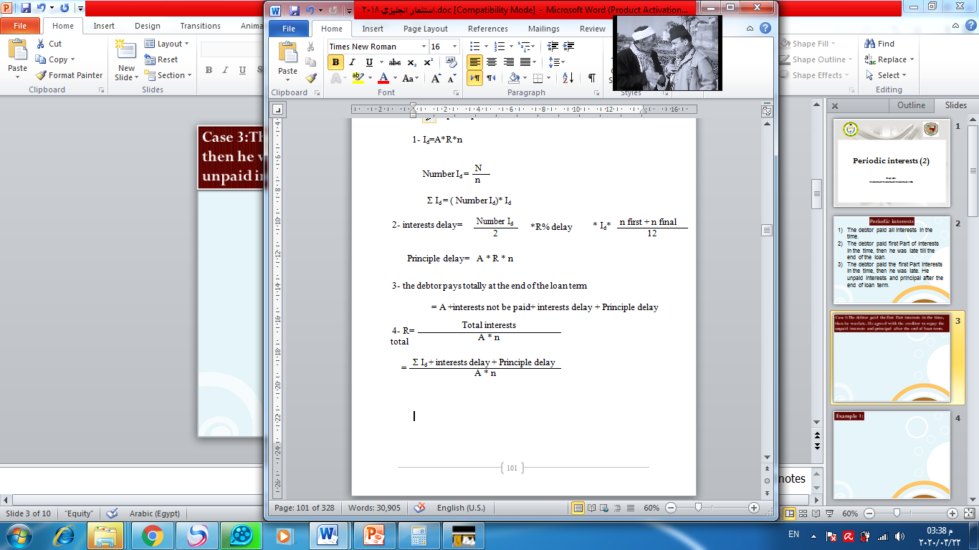
Case 3:The debtor paid the first Part interests in the time, then he was late. He agreed with the creditor to repay the unpaid interests and principal after the end of loan term.

Slide 4
Example 1:
A person borrowed 10000 $ from Cairo Bank for five years. He agreed with the creditor to repay the periodic interests regularly every six months. at an interest rate 10 %. The debtor paid the first five interests regularly, then he was late. He agreed with the creditor to repay the unpaid interests and principal three years after the end of loan term. Late rate is 20% for interests and 15% for principal.
Get the following:
Periodic interest and total periodic interests at an interest rate 10%
Interests delay for interests and principal
What the debtor pays totally after the end of the bank delay period
The general real interest rate that the debtor reached

Slide 5
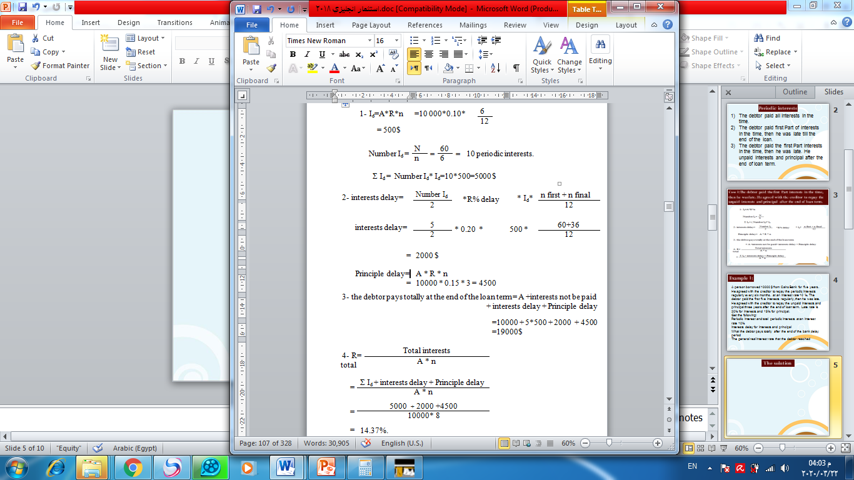
The solution

Slide 6
Example 2:
Amr borrowed 80000 $ at an interest rate 10% from Misr Bank. He agreed to pay the loan after a year and half. He will also pay interests periodically at the end of the month. He paid the interests of the first year and delayed the other interests payment. He delayed the loan payment for six months after the end of its term. Late interests of the late interests will be 11% annually and late interests of the principal will be 12% annually.
Get the following:
1-Total of the debtor's payment at the end of late term
2-The actual interest rate that the bank achieved

Slide 7
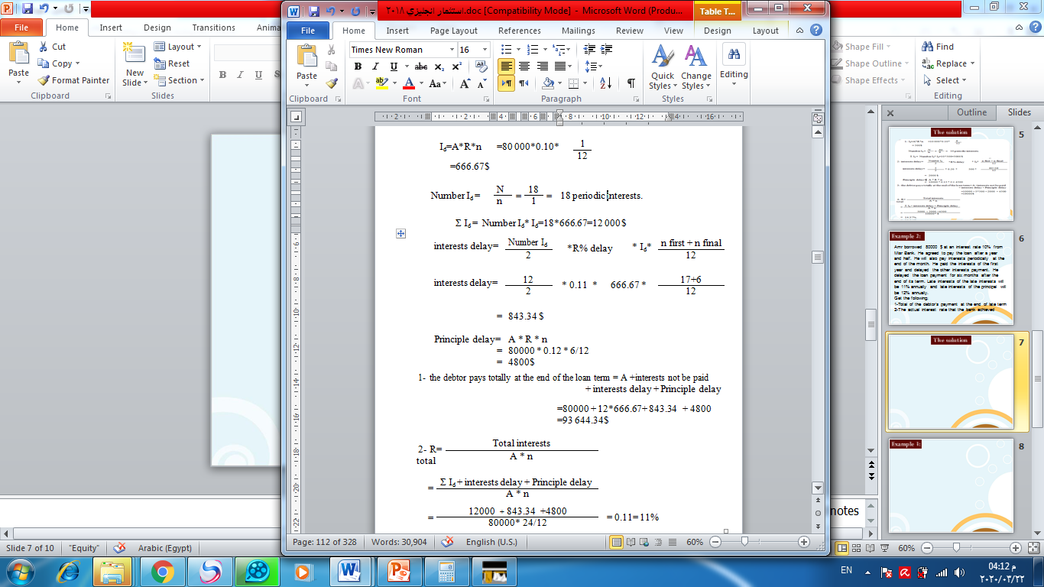
The solution

Slide 8
Example 3:
A merchant borrowed 19000$ for four years. He committed to pay off the principal at the end of the term and the interests periodically at the end of every four months at an interest rate 5%. He paid seven interests only. He agreed to pay off dues after seven months delay at late rate 6.5 % within loan main term and late rate 7.5% within late term.
The lender wanted to invest paid interests, when he gets them, at a rate 8.5%.
What is the actual rate of the creditor's interest?

Slide 9
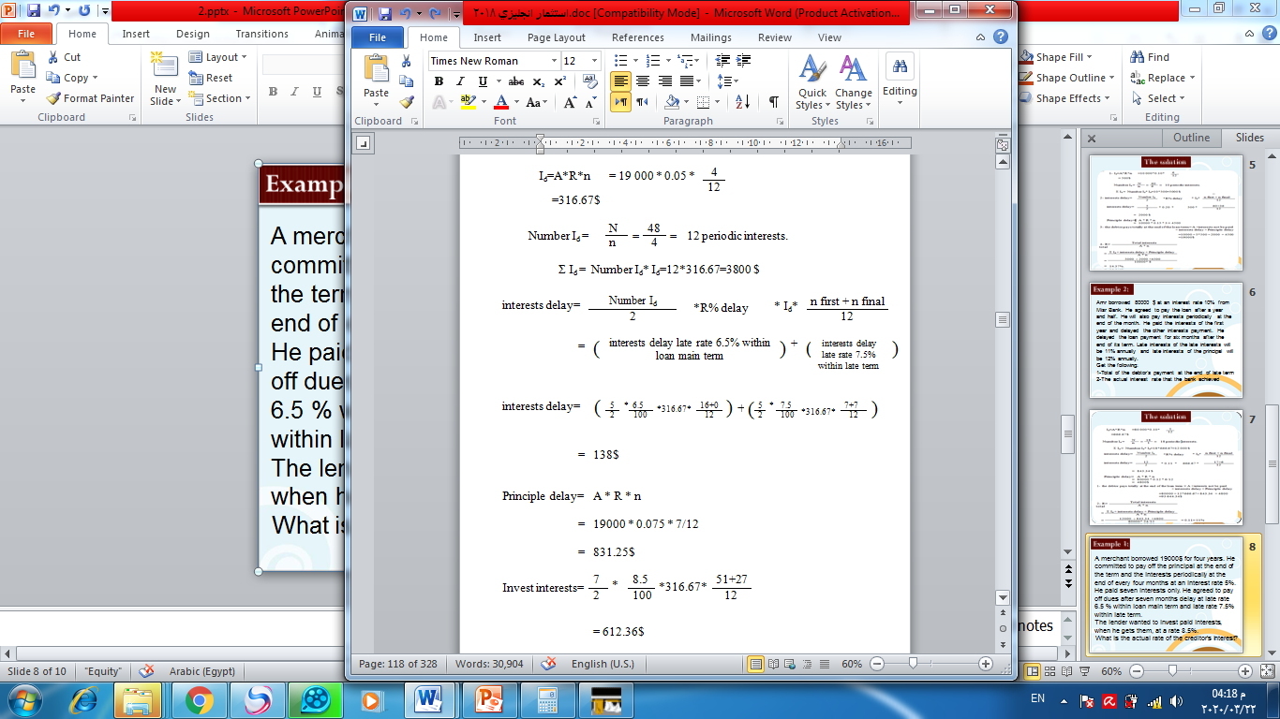
The solution

Slide 10
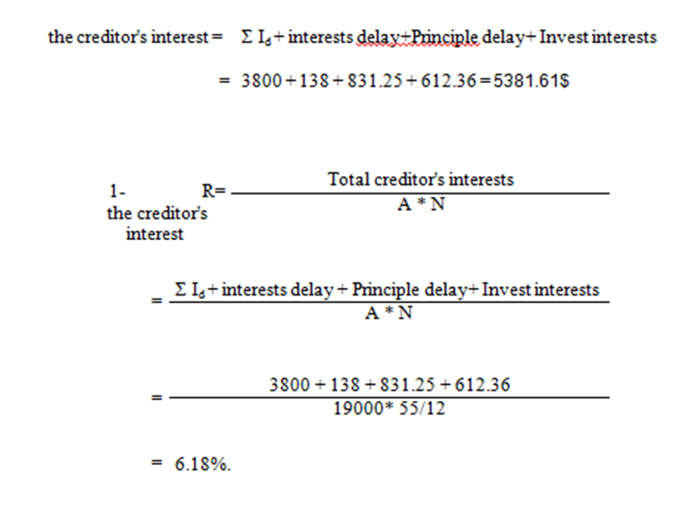

Slide 11
With best wishes

